Slide 1

Karlsruher
Institut
Für
Kœri
Torben G. Ella S. Philip S. Benedikt K. Jannick W.

Slide 2


Vision
Finding rising startup
Consider recent trends and news
Fast acquisition of relevant data
Precise data overview

Slide 3
Problem
Information overload
Scattered or biased data
No access to data
Correct priorization of tasks

Slide 4

Road-map
Analyze pitch decks
scraping of Real-time news
AI web-research
Automated scoring
Portfolio advisory

Slide 5
Value
Investors:
Broad view on multiple startups
Information about current market situation
Time efficient evaluation
Founders:
Accelerate funding
Evaluation of competitors
Notes:
Time evaluation of multiple possible unicorns

Slide 6
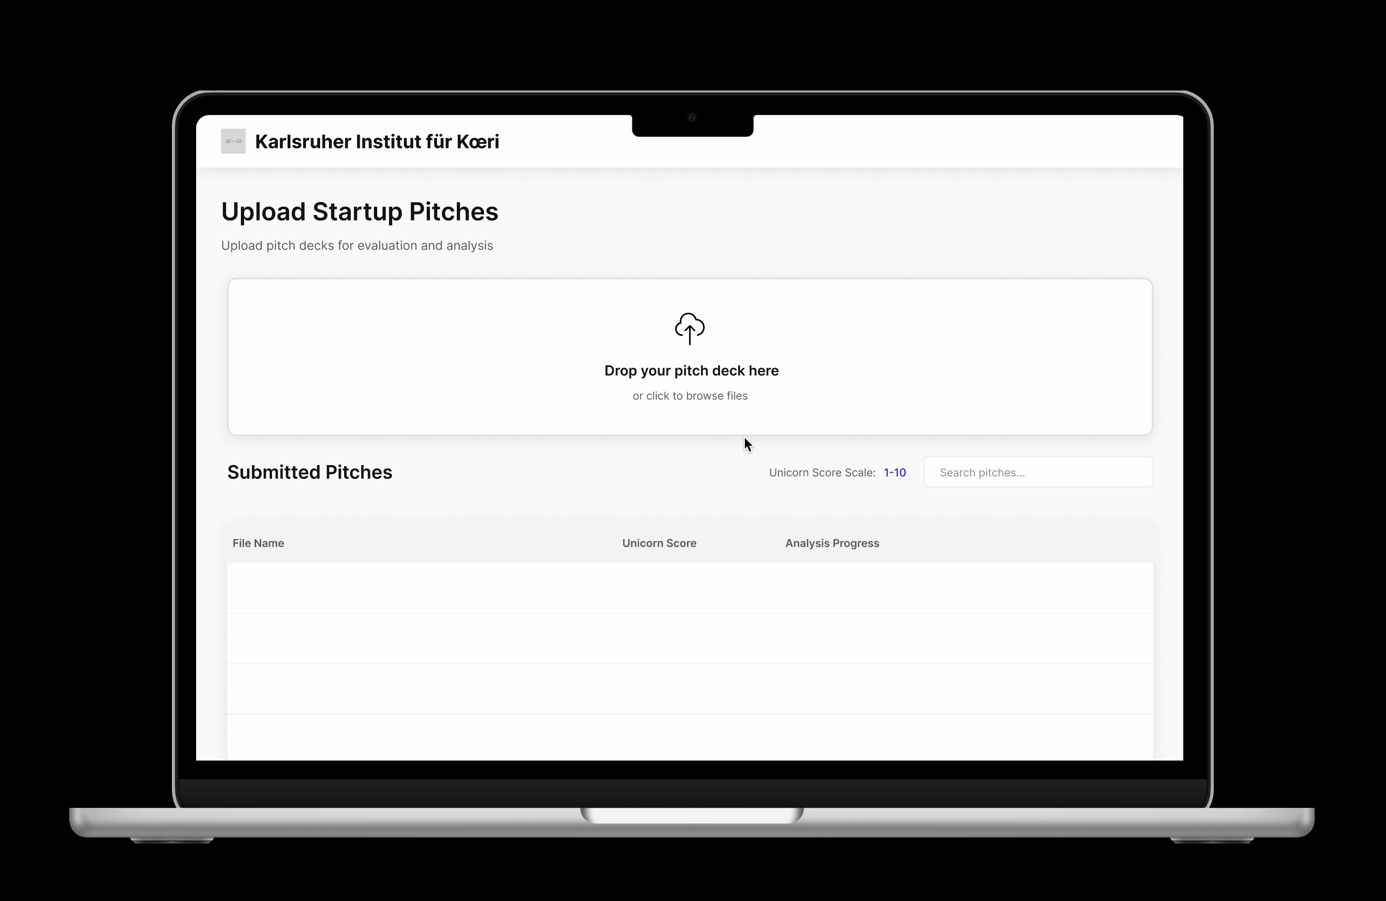

Slide 7
Our Approach
Extract valuable information from pitch decks using OpenAI - VisionAPI
Crawl reputable news publishers
GPT-Internet research for market situation and massing details
Using of AgenticAI for expert evaluation
Notes:
Automted AI Portolio compilation showing the best portfolio composition
AnalystAI, ResearcherAI and Protfolio consultant

Slide 8

Questions

